Slide 1


Peer Review
2022.3.7

Slide 2

Peer review
Definition
Peer review, also known as peer feedback, peer assessment or peer editing, refers to an instructional activity where peers in pairs or groups exchange the feedback on their writing draft in oral, written or a mix of oral and written mode, whose process and product are always handled as a whole.
Benefits
Firstly, learners are powered to independently take the responsibility for their writing and improve their writing ability by reading other’s drafts critically. Secondly, learner’s audience awareness is enhanced and it can help learners mitigate the effect of egocentrism in their own writing. Finally, peer review also generates the benefits of the cognitive strategies and social skills, such as communication skills, negotiation techniques.
SUBTITLE

Slide 3





Process
reviewing
giving comments
receiving comments
learners=reviewers
improvement
revising the draft
learners=writers

Slide 4

Abstract in English academic writing
Abstract is an important part of academic papers, with independent discourse structures and stylistic features, which works a crucial role in the delivery of text information.
A qualified abstract is an important condition that the academic papers can publish in the international journals in accordance with native’s habits.

Slide 5

First offline activity
Write /prepare an abstract about 200-300 words.
Second offline activity
Review others’ drafts and give peer comments under the guidance of writing rubrics.
Third offline activity
Revise drafts by referring to received comments.

Slide 6

First offline activity
Write /prepare an English abstract about 200-300 words.
Be original.
It can be the part of abstract in the your published/unpublished/course paper.
If necessary, translate it into English version.
You have one week to finish it.
Great efforts are not necessary to strive for perfection.

Slide 7

Second offline activity
Be well-informed of the writing rubrics before reviewing the drafts.
Review others’ drafts and give peer comments under the guidance of writing rubrics.

Slide 8

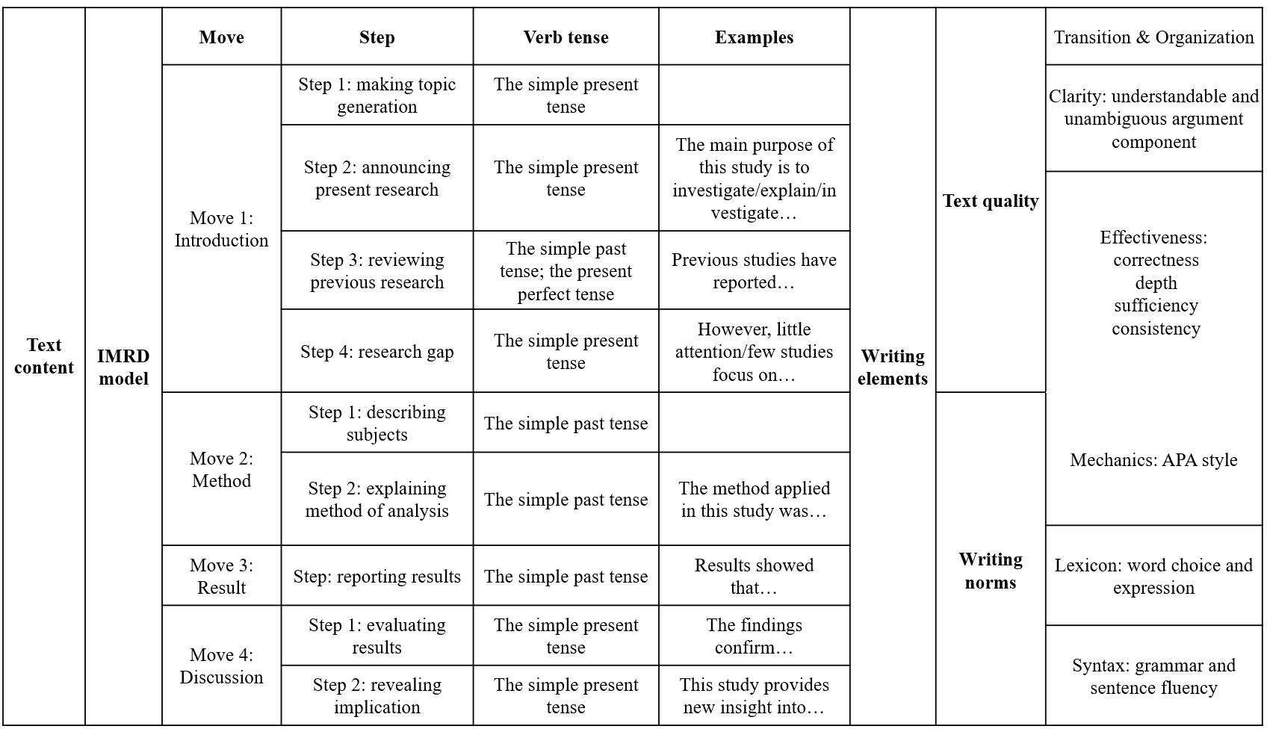

Slide 9

Text content – IMRD model
摘要的宏观语步结构
语步切分参照Swales(1990)的IMRD四语步模式。
I语步主要包括研究背景、研究问题、研究假设或研究目的、研究的重要性等;
M语步主要包括研究资料收集、研究所用方法、研究采用的理论框架、研究数据或理论分析过程等;
R语步一般涉及研究结果展示，包括研究的主要发现、对于假设或问题的验证结果及研究目的实现性等;
D语步主要包括研究结果以外的重要发现、研究的意外收获、对理论或实践的启发参考意义等。
Move 1: Introduction
Move 2: Method
Move 3: Result
Move 4: Discussion

Slide 10
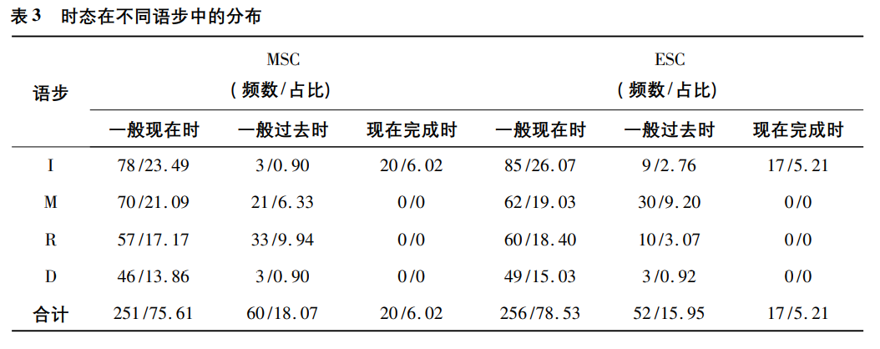
Text content: Verb tense and Sentence pattern
时态：一般现在时、一般过去时和现在完成时
中国大陆学者语料库
英语母语学者语料库

Slide 11
在时态运用上，需理解不同时态的语法和语用意义。
I 语步使用一般现在时介绍研究目的、范围、意义等以突显这些方面与所做研究的直接关联性，使用现在完成时介绍研究背景，强调其作用与影响;
M 语步需摆脱过分依赖一般现在时的思维定势，使用一般过去时描述论文撰写前已完成的工作，呈现数据收集、展现研究过程等;
R 语步中国大陆学者在R语步中过多使用一般过去时，对这一语步中时态的语用意义缺乏精准的把握。若使用一般现在时来描述结果，体现研究结果的可信度和普适性;
D 语步使用一般现在时讨论结果的意义和影响来加强读者的可介入性。

Slide 12
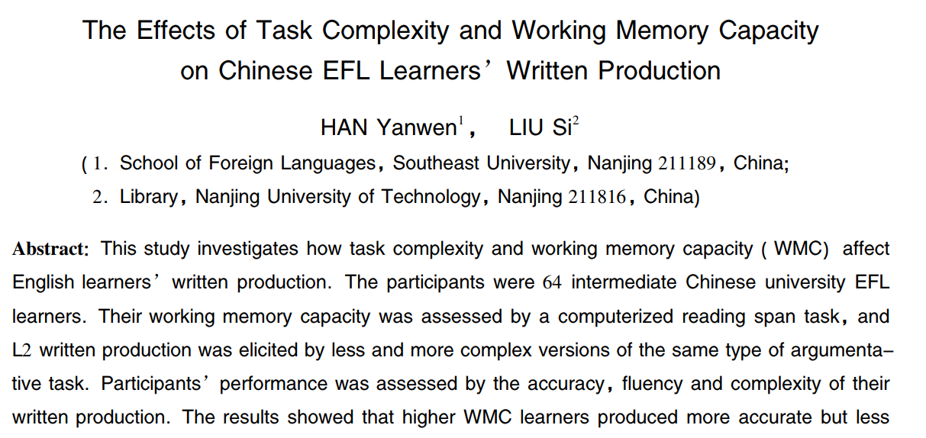
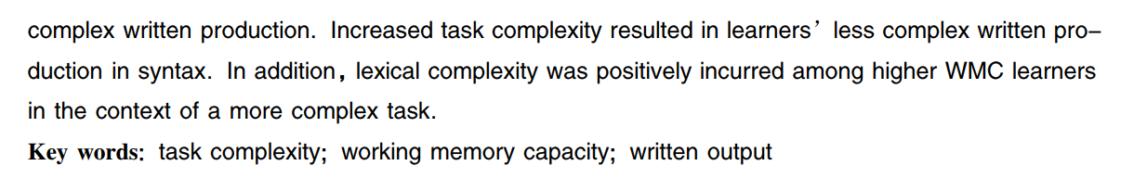

Slide 13
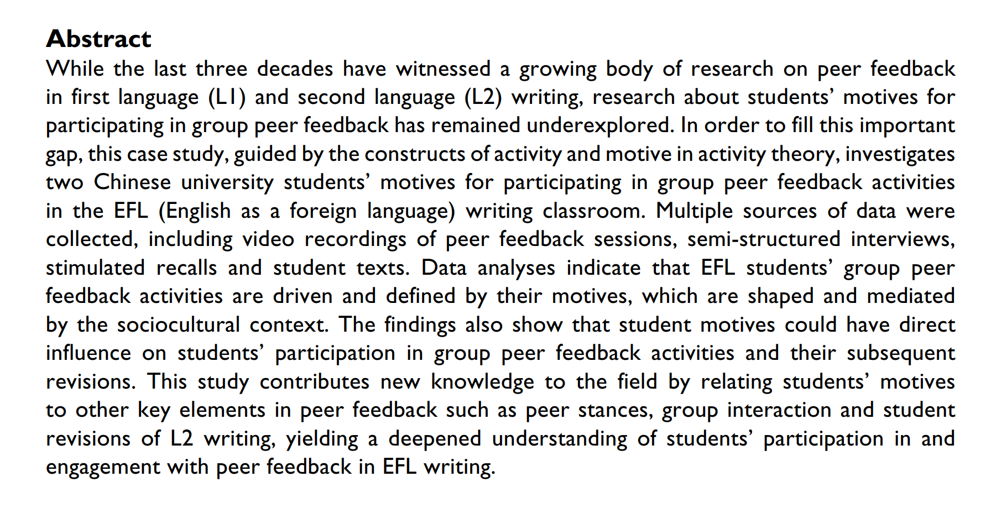
I 语步
M 语步
R 语步
D 语步
(Yu, S. L. & Lee, I. (2015). Understanding EFL students’ participation in group peer feedback of L2 writing: A case study from an activity theory perspective. Language Teaching Research, 19(5): 572-593.)

Slide 14

Text content 评阅维度
结构是否完整？== 是否简明概述研究
时态是否正确？== 多余的时态（将来时）？时态是否一致？
典型句型的运用？

Slide 15
Feedback types | Examples
Supporting | Comments containing support or praise （肯定，赞扬等）
Opposing | Comments simply showing negative feelings about the work （否定等）
Summary | Comments condensing and reorganizing the information into chunks （归纳总结所得信息）
Localization | Comments pinpointing the problem in the work （指出问题/错误）
Explanation | Comments providing motives or clarification of the feedback （阐明问题/错误，说明原因）
Solution | Comments explicitly suggesting a method to deal with a problem （提供解决方法）
Evaluation | Comments about verification of knowledge, skills, or strategies （肯定，否定，或说明作者摘要写作运用了某些知识，技巧，策略等）
Reflection | Comments challenging the work for the writer to reflect on or think about thoroughly （提出疑问使作者反思其摘要写作）

Slide 16


Writing elements
Text quality:
Clarity: understandable and unambiguous argument component
Transitional words: discourse markers like “so, because, therefore …”
Effectiveness of Argument
Correctness: factually correct or infallible argument component
Sufficiency: adequately presented support for the claim
Depth: original, non-obvious, and/or sophisticated arguments.
Consistency: arguments being logically consistent with each other and presented evidence
Writing norms:
Mechanics: APA Style: citation, reference, etc.
Lexicon:
Word choice: concise, precise and exact word to convey meaning
Expression: the way to build a phrase or sentence different from and unacceptable for native speakers
Syntax：
Grammar: lexical usage and/or syntactical usage
Sentence fluency: a variety of sentence to achieve different effect

Slide 17
标题文本预设
01
标题文本预设
02
标题文本预设
03
标题文本预设
04

Slide 18

Click here to add you to the center of the narrative
thought Click hereto add you to the center of the
narrative thought Click here to add you to the center
of the narrative thought
Click here to add you to the center of the narrative
thought Click hereto add you to the center of the
narrative thought Click here to add you to the center
of the narrative thought
Click here to add you to the center of the narrative
thought Click hereto add you to the center of the
narrative thought Click here to add you to the center
of the narrative thought
AV AVE
CHNMAOL

Slide 19

20XX
东南大学PPT模板

